Slide 1

Hosting An Art Exhibit
Taylor Bailey
CPT 270-W01
Sponsored by: South Carolina Arts Commission

Slide 2

Project Idea
The purpose of this project is to provide upcoming artists both new and experienced with an exhibit for showcasing and selling their artwork to the public.
Visitors will be allowed to purchase art pieces if the artist has chosen to sell them.

Slide 3

Project Scope
This exhibit will provide exposure and potential revenue for artists in the Lowcountry. A majority of art sale revenue goes directly to the artist.
In addition, a portion of the all of the exhibit’s proceeds will be donated to arts education.

Slide 4

Project Constraints
REQUIRED:
A sponsor to fund the exhibit
A proper venue to host the exhibit
Participants/Artists
Supplies for development and
hosting the event
Project budget is not to exceed $5,000

Slide 5

Project Dates
START DATE: May 12th 2019
END DATE: July 18th 2019
Key Dates:
Venue use and preparation: July 15th-18th
Exhibit to be hosted on July 15th 2019

Slide 6

Key Members
Exhibit Sponsor:
South Carolina Arts Commission
Project Manager
Taylor Bailey
Team Members
Judith Ponds
Timothy Ponds
Leslie Browning
Blake Lindern
Jennifer Mesach

Slide 7
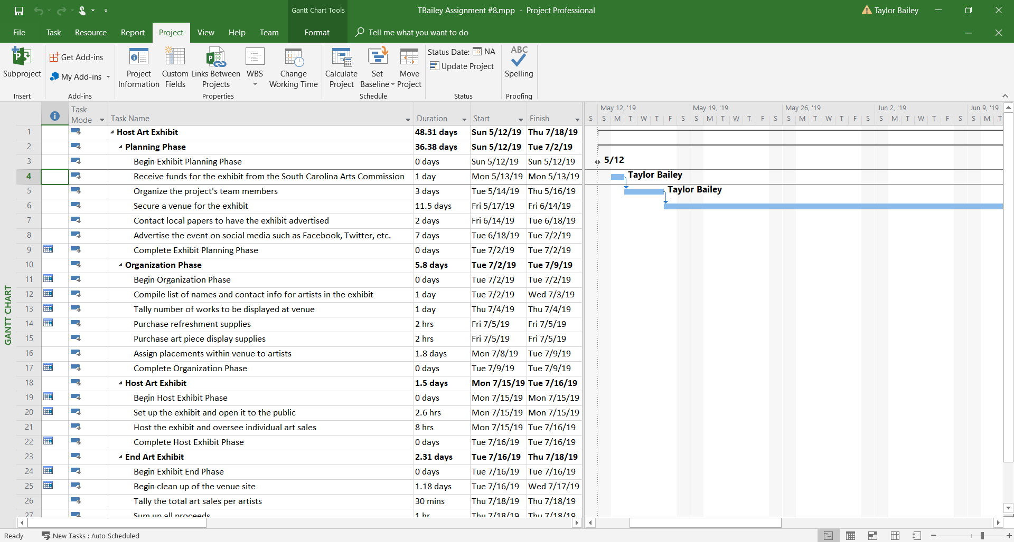
Detailed Gantt Chart

Slide 8
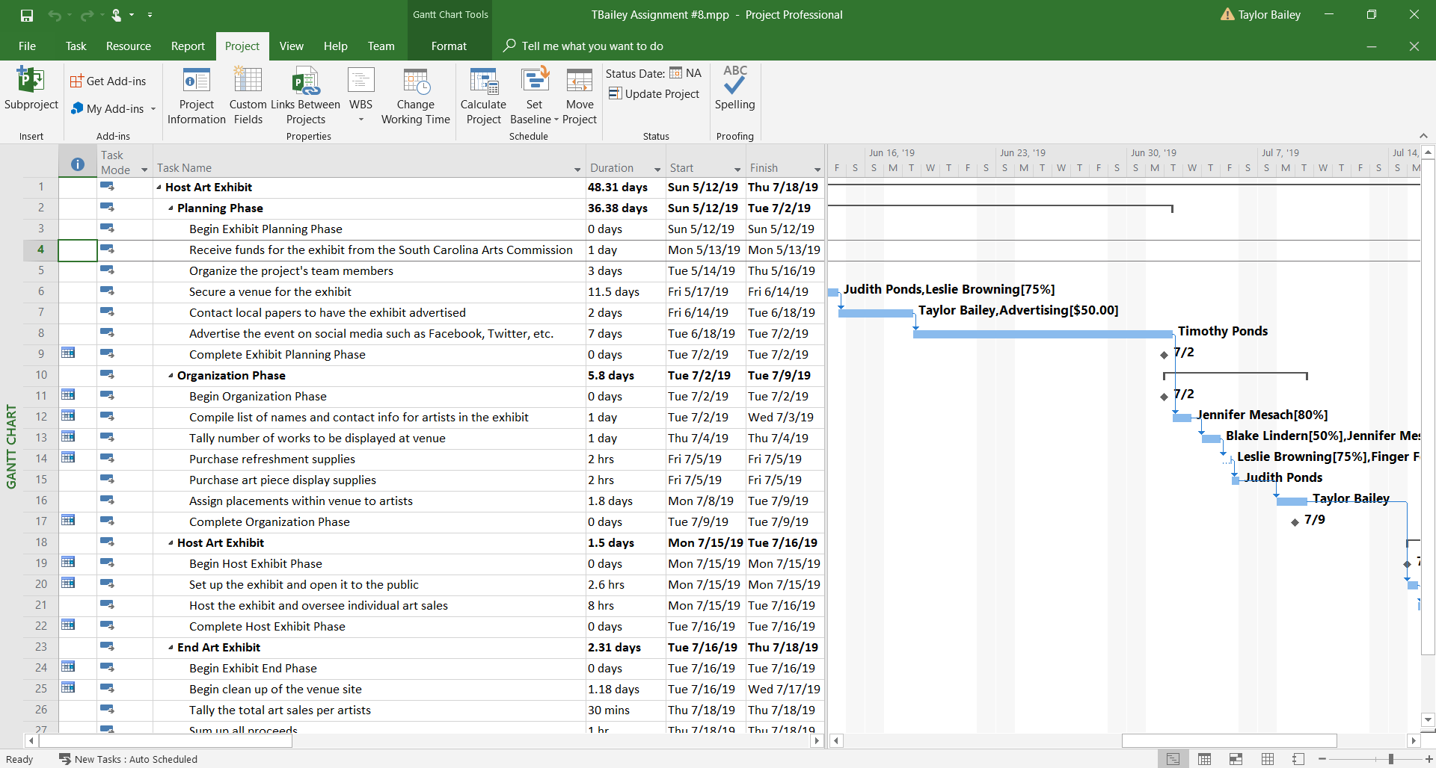
Detailed Gantt Chart Cont.

Slide 9
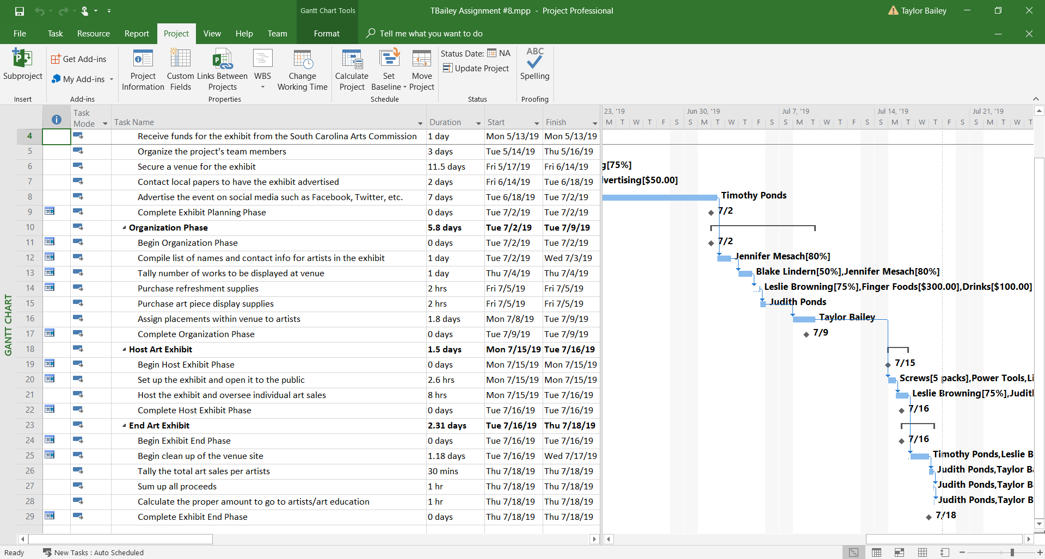
Detailed Gantt Chart Cont.

Slide 10
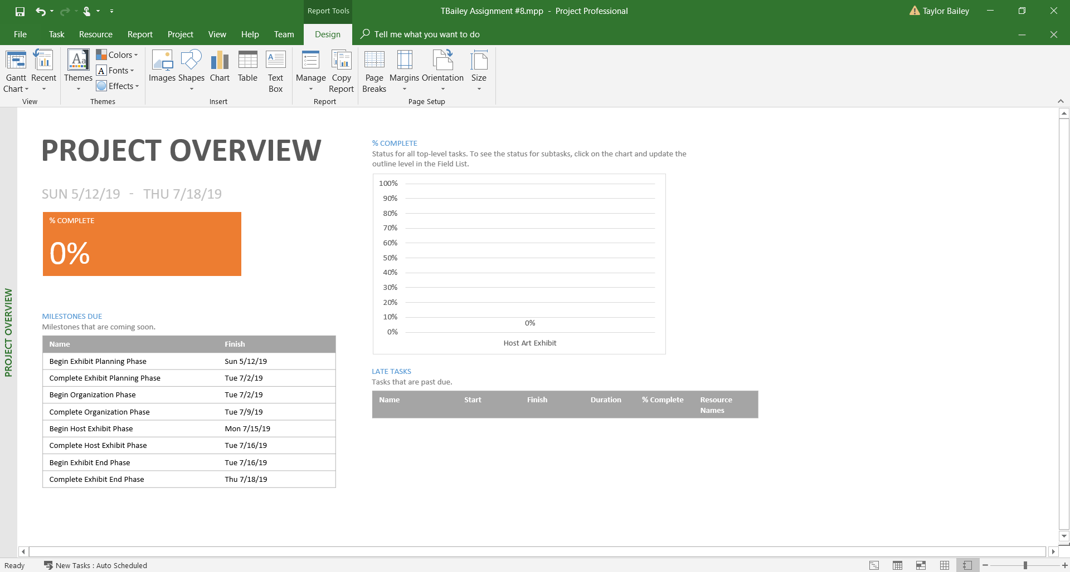
Project Overview Report

Slide 11
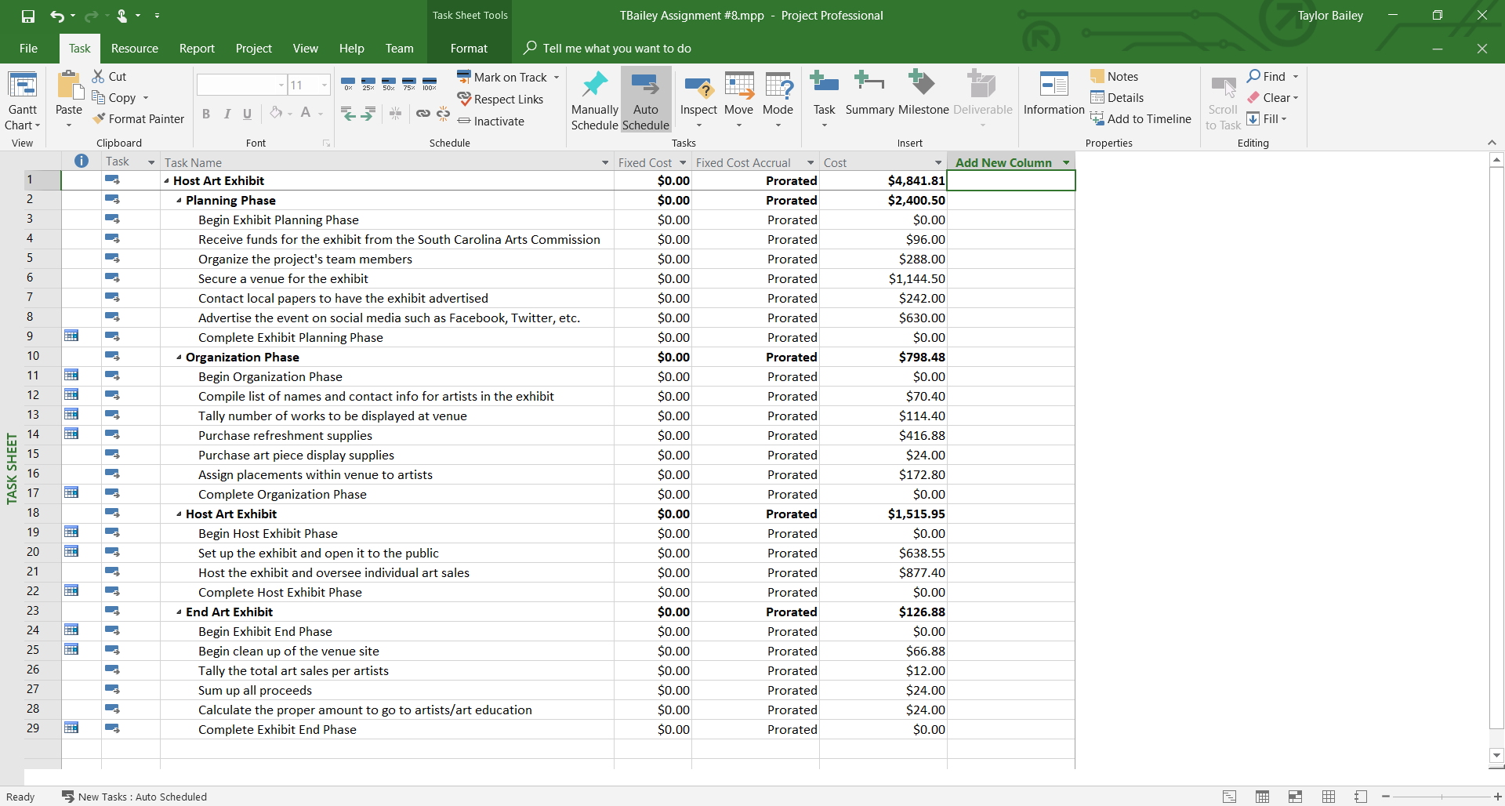
Budget Report

Slide 12
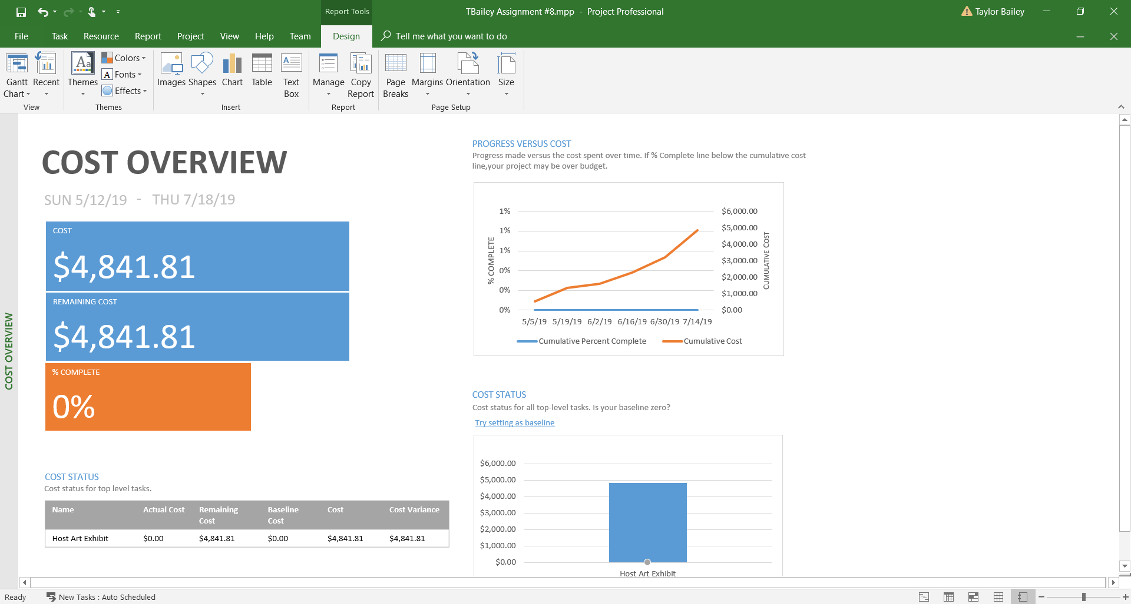
Cost Overview Report

Slide 13
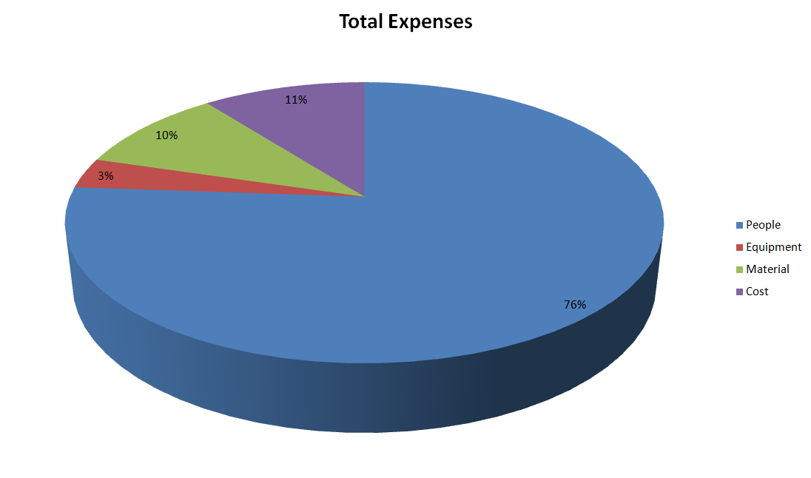
Excel Chart

Slide 14

Conclusion/Summary
This exhibit will be of superior quality.
By the end of this project, significant funds will have been raised for both participating artists and art education donations.
This project will be under budget at $4,841.81

